Slide 1
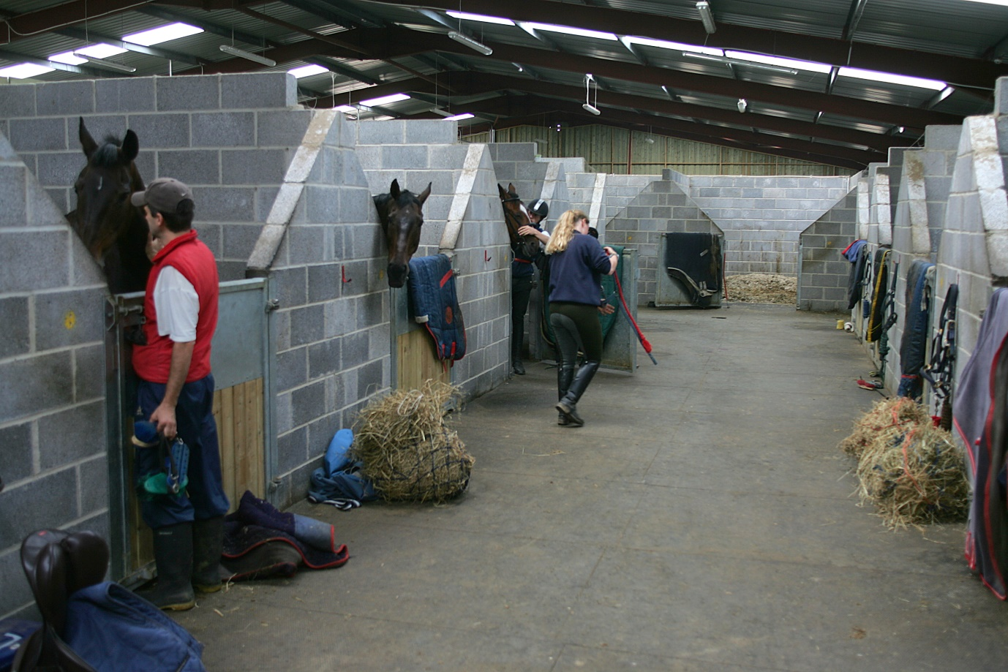
LIVERY
Competition & Training Livery
Full Livery
Livery discount for students on BHS Courses
Overnight livery available
Tailored packages available for individual needs.
Notes:
The title of main point #2 should be clear and concise. Each piece of evidence should be summarized for clarity and cited correctly. Do not simply read the pieces of evidence, but elaborate where needed.
[type notes for elaboration here]
Be sure to transition to main point #3 and the next slide.

