Slide 1

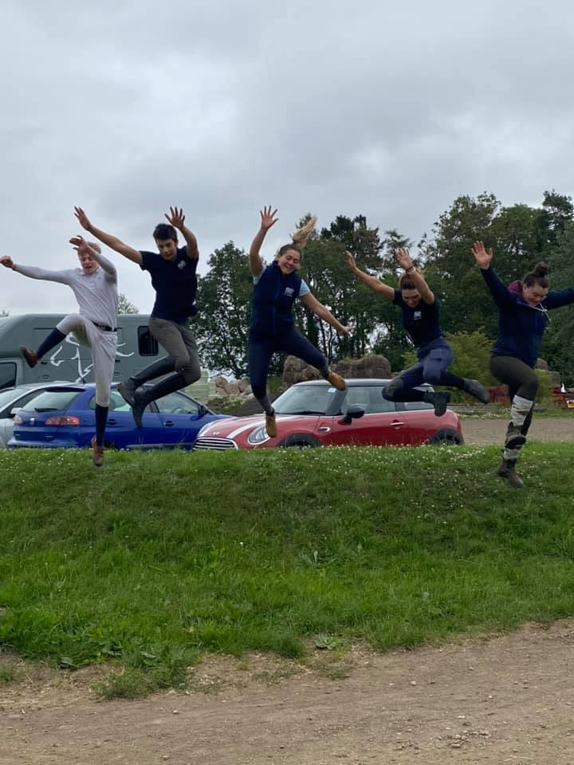
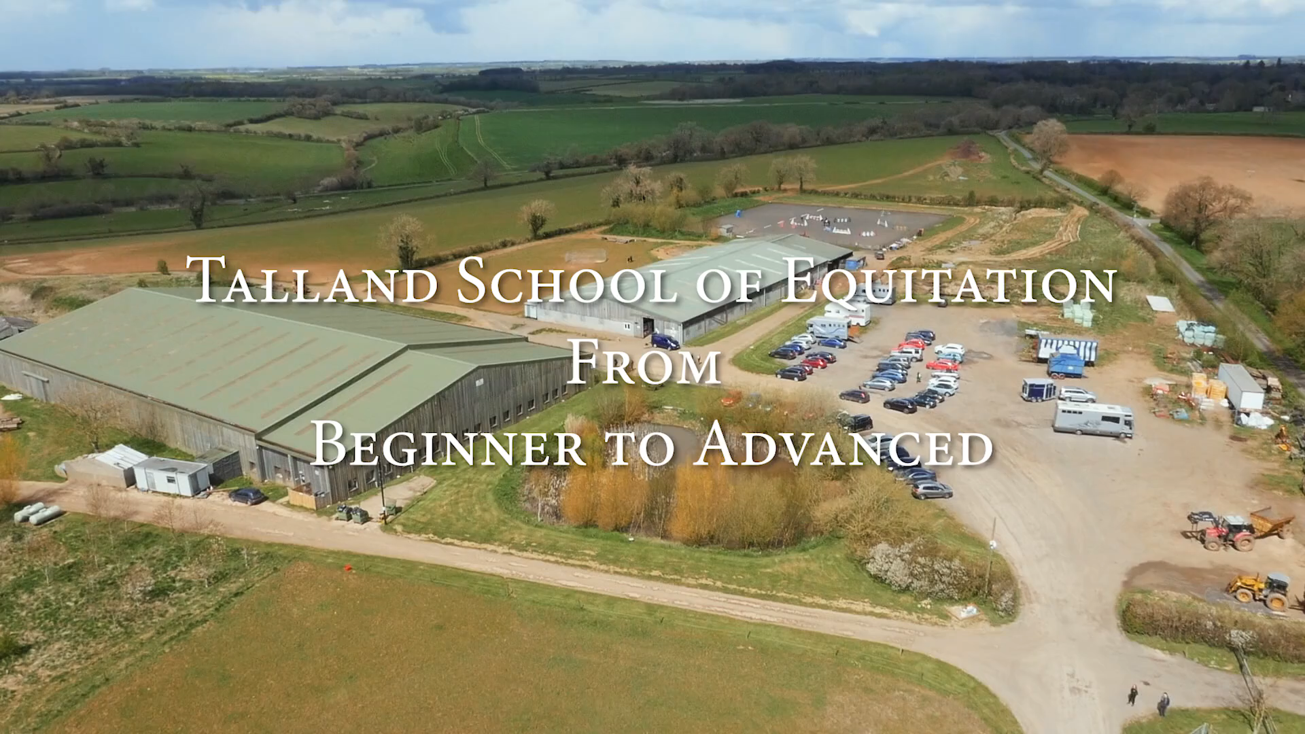
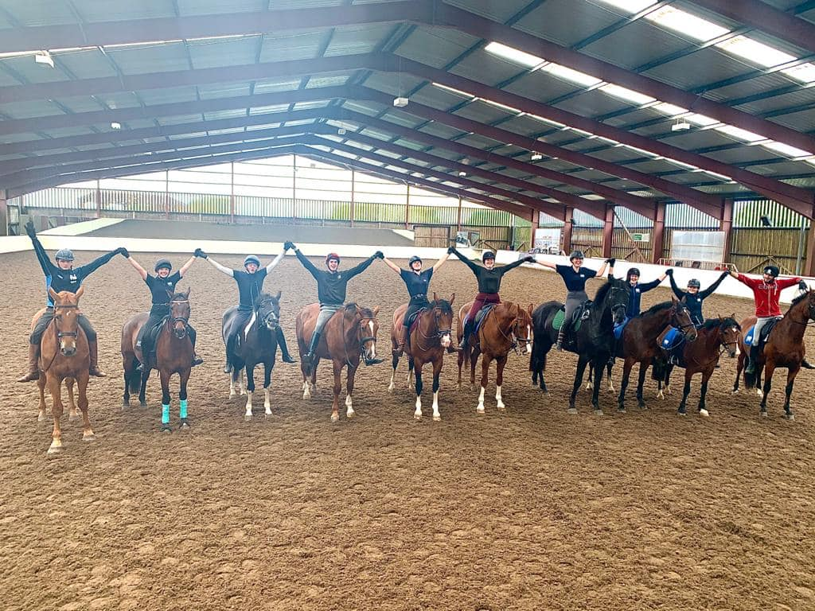
TALLAND TRAINING OPPORTUNITIES
World class Trainers and Horses
Training with the Hutton family and The Talland Team.
100% exam pass rate 2021.
Staff and instructors onsite.
Full time residential training options.
Training from Stage 1 to BHSI.
Short and Long term options.
Learn to really ride and train.
BHS exam centre.
Talland trained students in demand worldwide.
Email: secretary@talland.net
Telephone 01285 740155
www.talland.net
Talland bubble photos taken during lockdown
Notes:
Use the background points to post details that are not common knowledge, or that the audience will need to understand the context of the speech.
-Do not read these main points from the PowerPoint, instead elaborate on these points during the speech.

