Slide 1
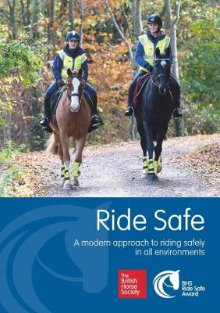
British Horse Society Ride Safe
Ride Safe Course May 2023
Ride Safe Course with an Assessment on the final day.
17th May: Day 1 Training
24th May: Day 2 Training
31st May: Day 3 Assessment
13.30am – 16.30pm all 3 days.
Please contact office@talland.net for info and to book.
BHS Silver Membership required. BHS Stage 1 and Ride Safe along with Gold Membership are prerequisites for booking BHS Stage 2 Ride.

